Slide 1
Group 3: Unifools
Justin Renneke, Zach Bryant, Mark Vassell

Slide 2

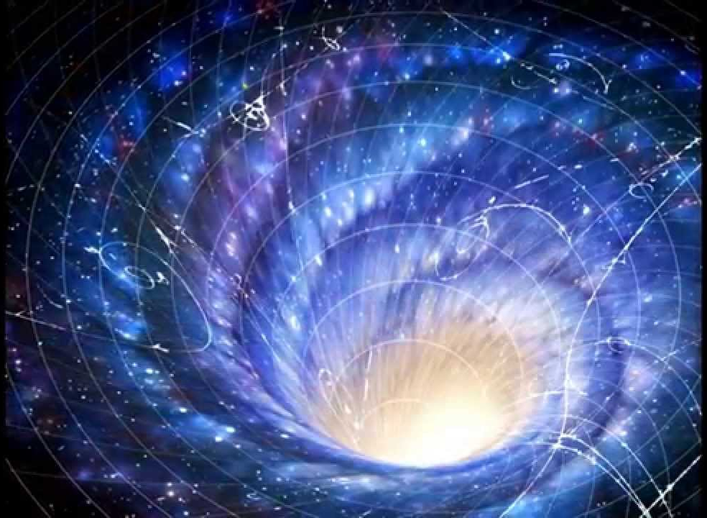
The Game
Everyone in the Town of Power is depending on the racer to save the world from invading aliens.
While racing to the save the town the racer must close the portals to prevent a larger invasion.
Once in the town the racer must destroy the invading aliens and close the remaining portals to be successful.

Slide 3


Implementation
Implemented in Unity
PC Game with VR support
Art assets and some libraries imported from Unity asset store
Over 2,000 Lines of Original Code
Bitbucket git repo nearly hit the 2 GB limit

Slide 4
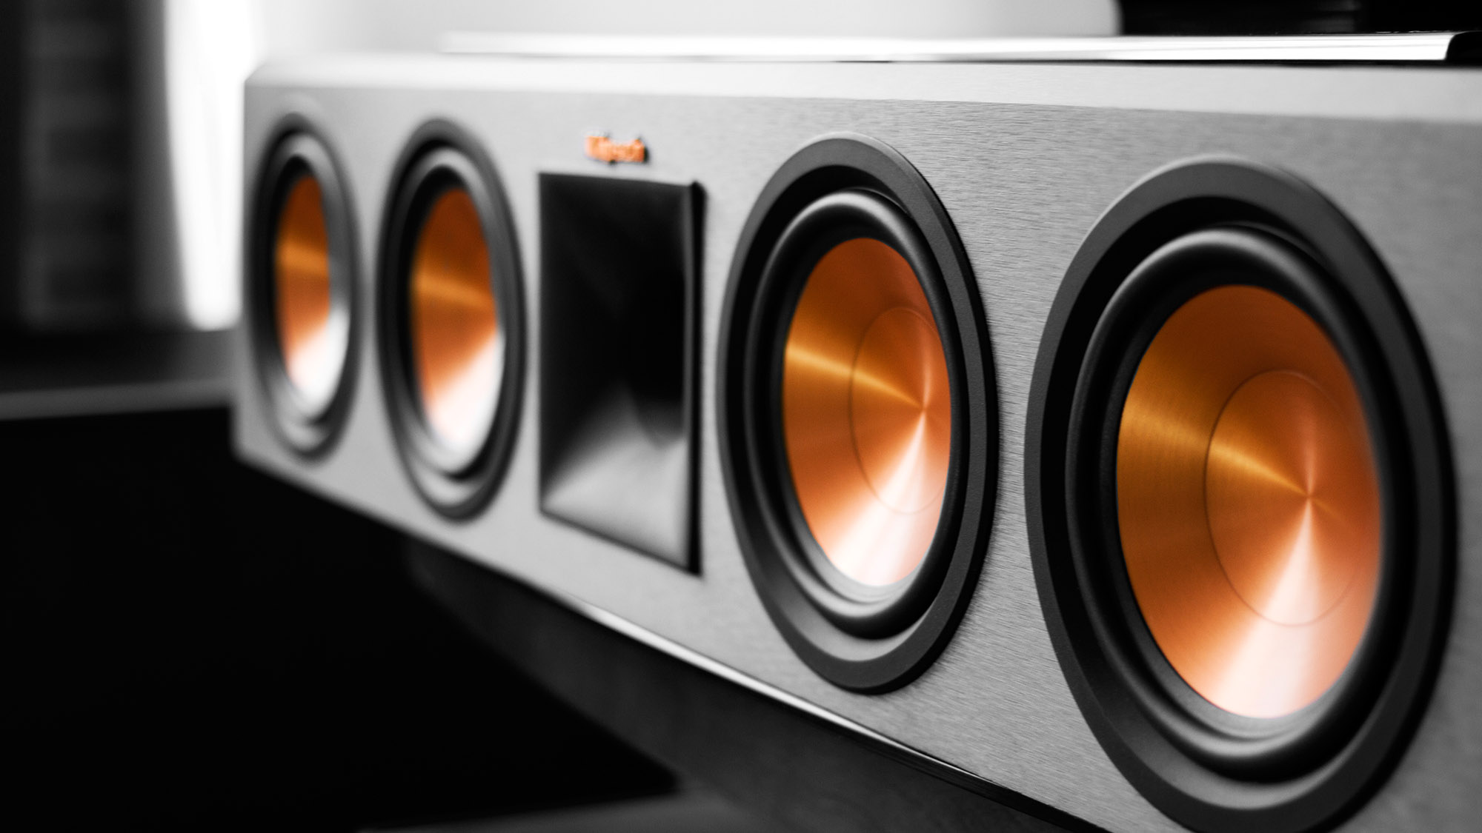
Sounds
The sounds are alien themes audio snippets.
They were imported as assets and integrated into the project.
They are triggered with onCollission() and onClick() functions.
The background music is attached to the gameObject and loops until the round is complete.

Slide 5
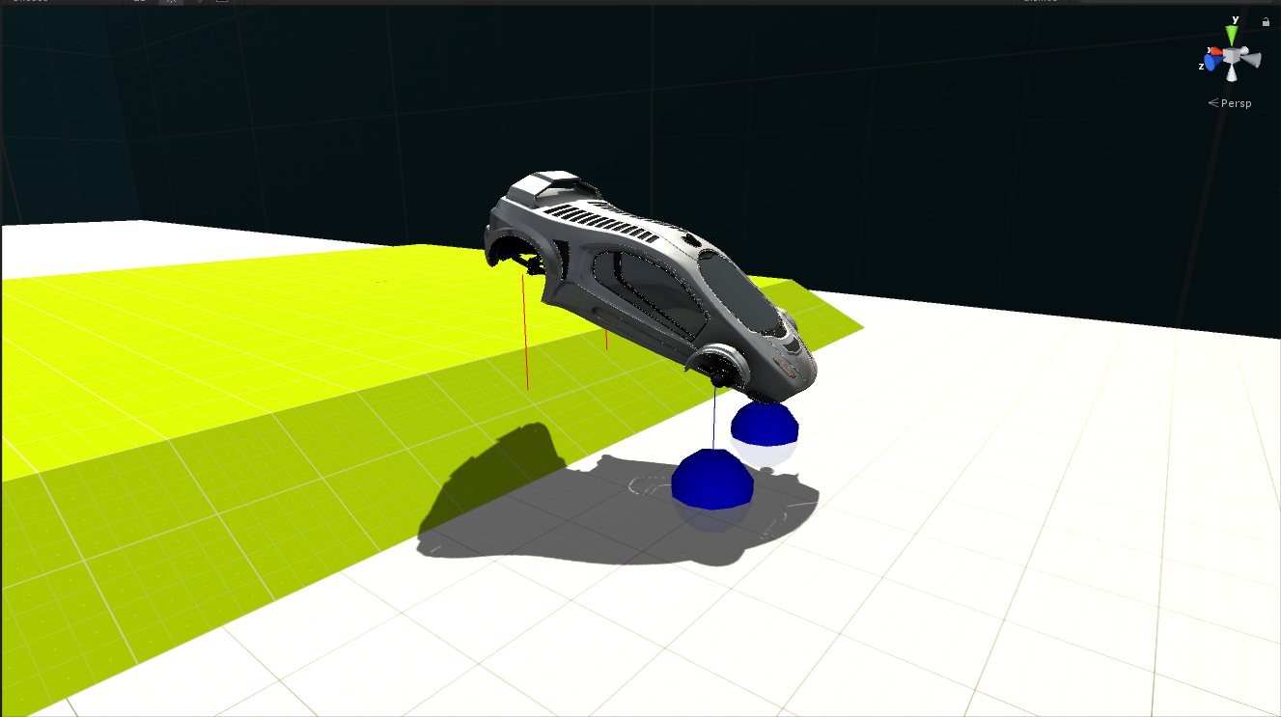
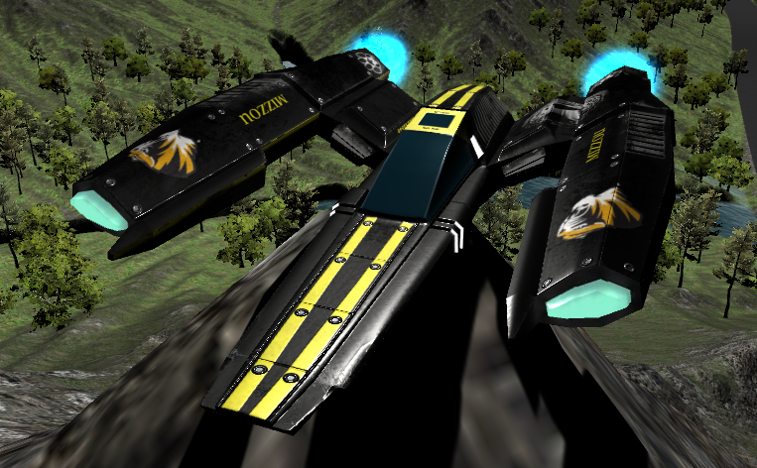
The Car
Prototype
Finished Product
Effects achieved with C# and Unity’s physics API
Normal navigation using W, A, S, D
Can ‘jump’ using spacebar
Activate thrusters (L or R mouse or arrows) to add force at thruster point which allows you to spin the car and build charge to perform special moves like energy pulse (Shift & E key)

Slide 6
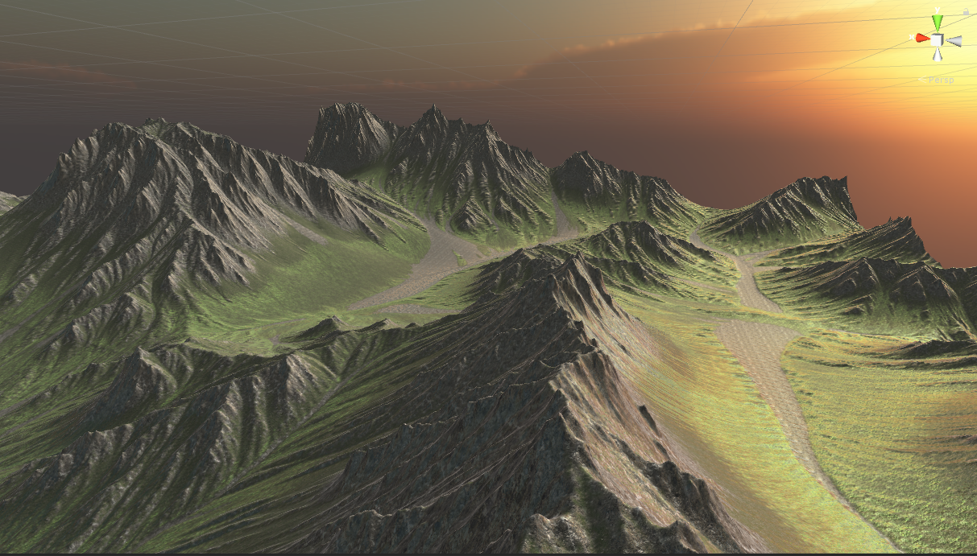
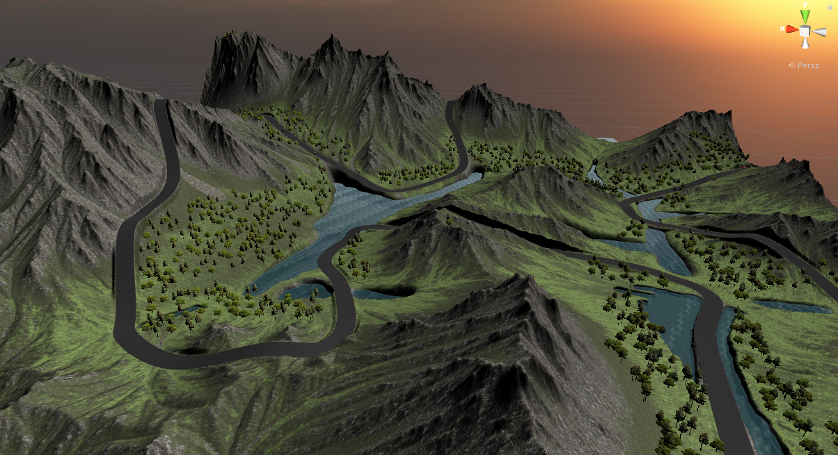
The Terrain
Base terrains were imported from asset store
Edited to suit our requirements
Reshaped large portions of terrain
Drew the race track
Changed lighting and added water and trees

Slide 7
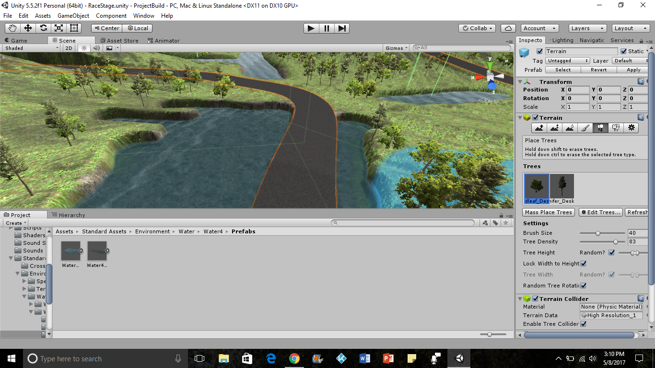
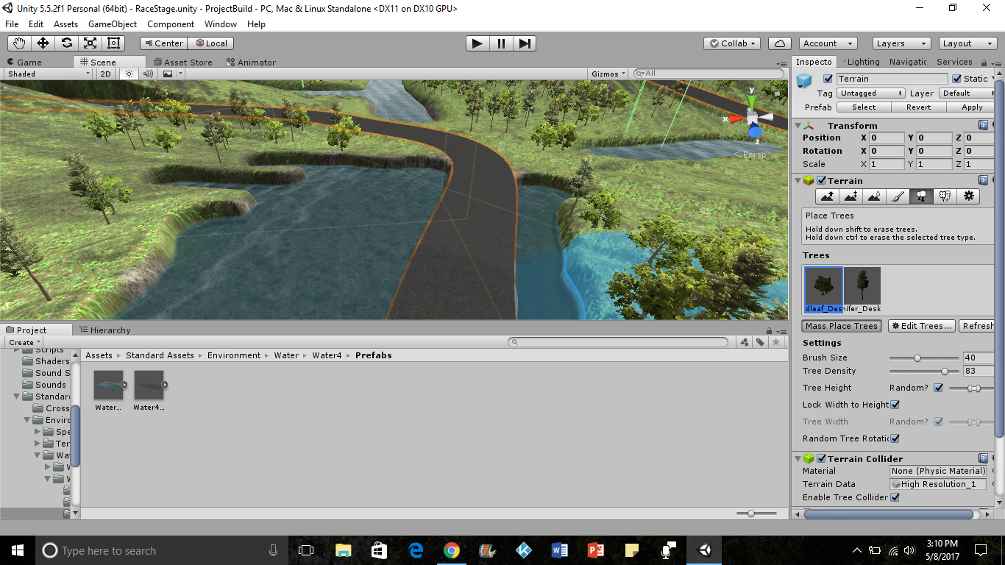
Creating the Environment
Trees

Slide 8
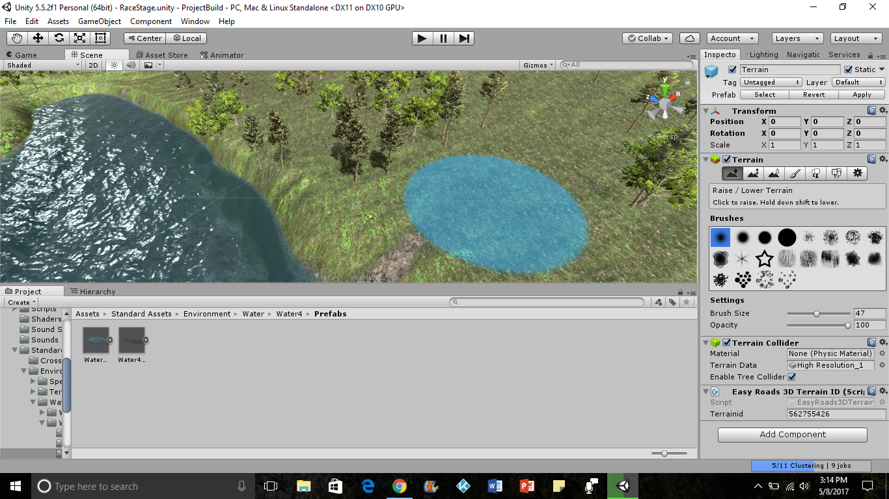
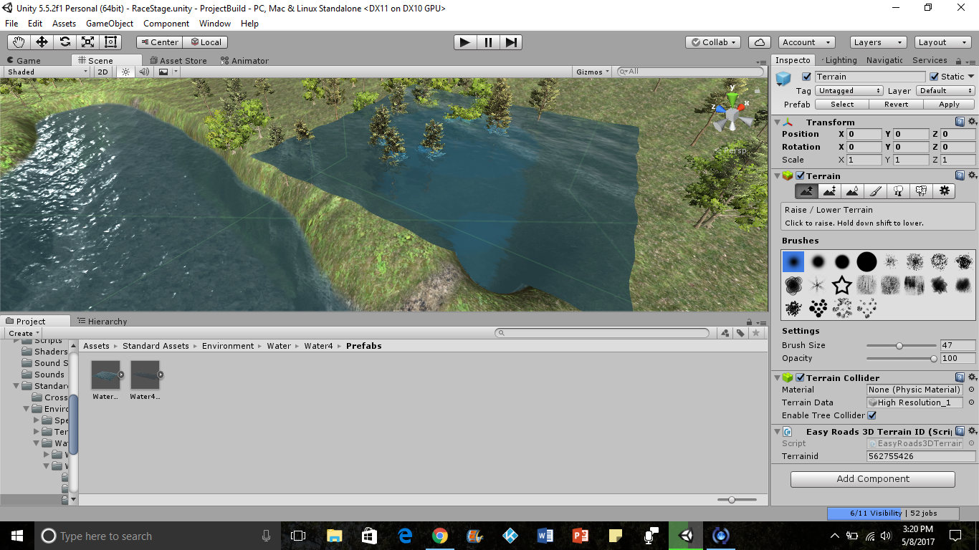
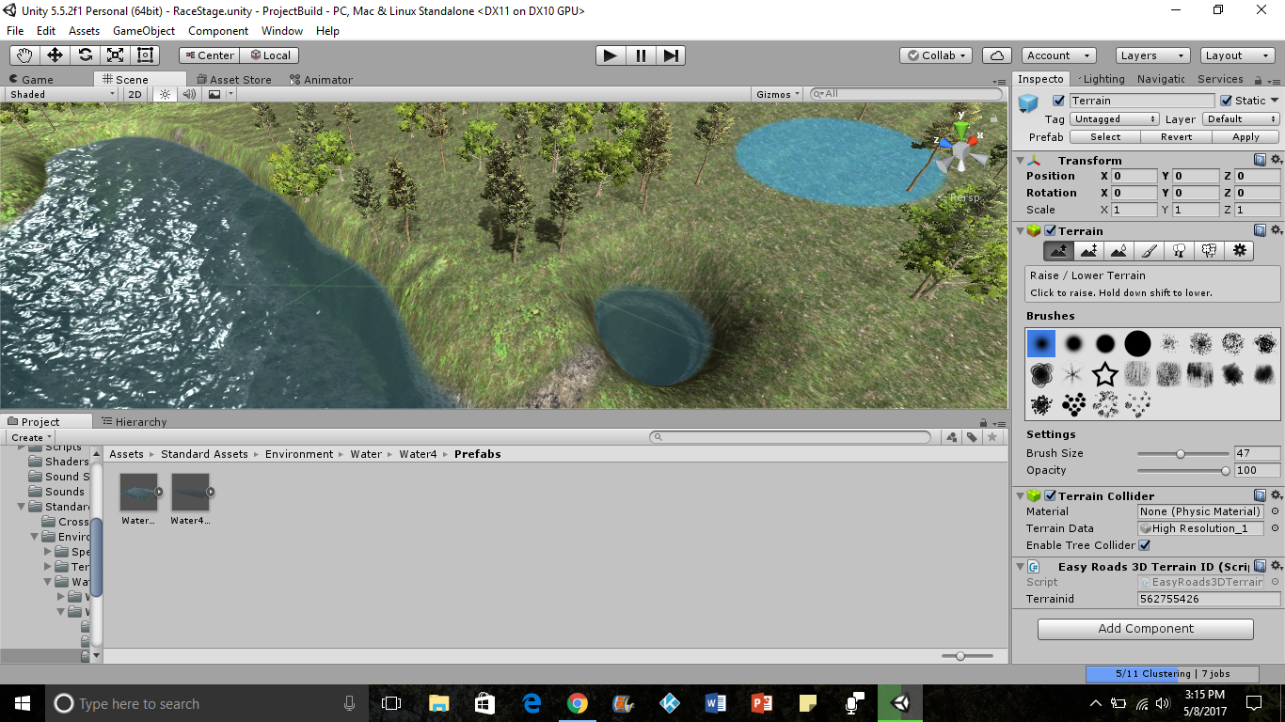
Creating the Environment
Water

Slide 9
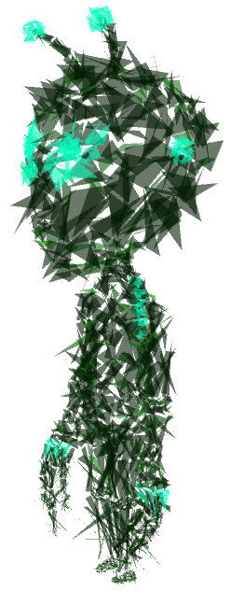
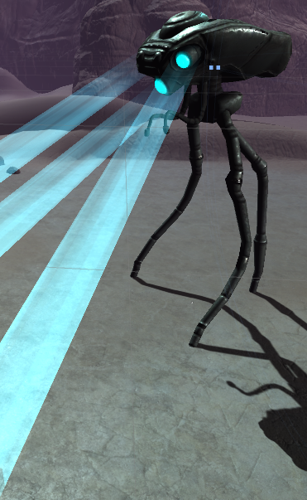
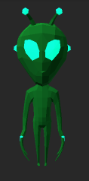
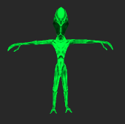
Aliens
Mostly low polygon models to increase performance
Given navigation AI via NavMesh and animated using human motion capture packages
Destroyed by collision with car body, car’s thrusters, or car’s energy pulse ability
Destruction animation utilizes mesh explosion library

Slide 10
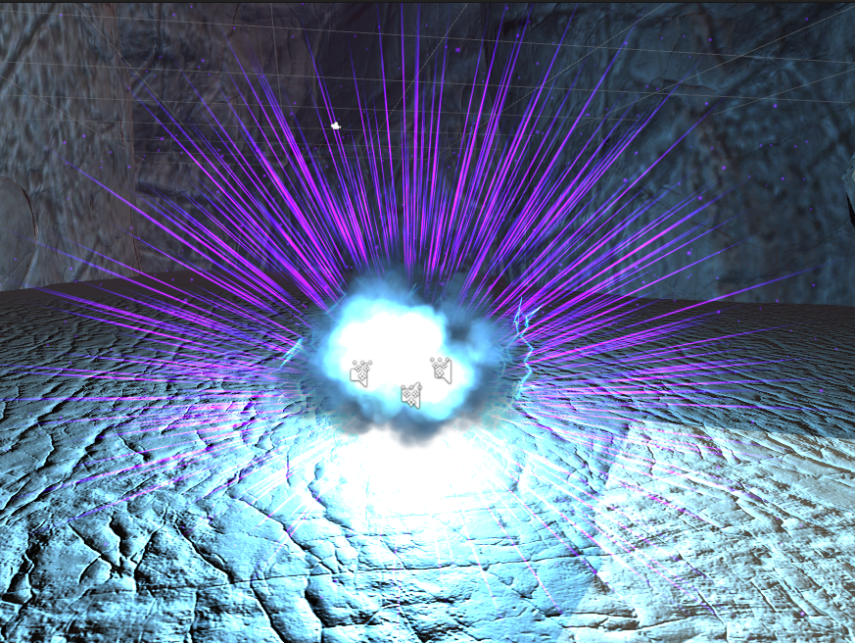
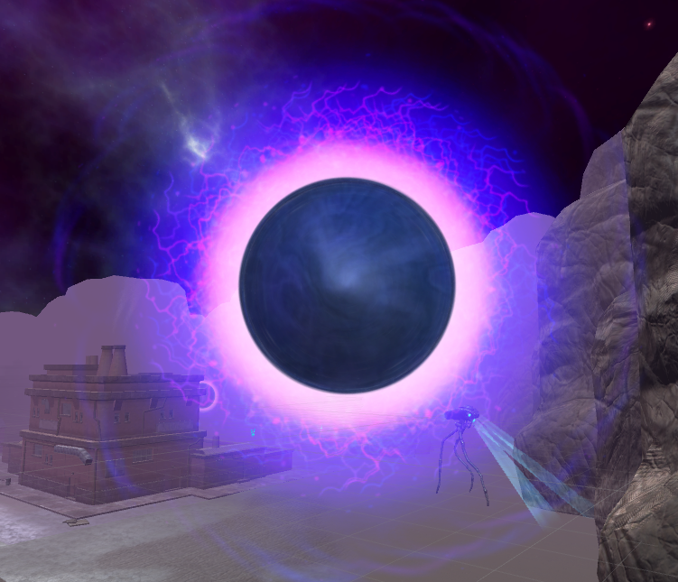
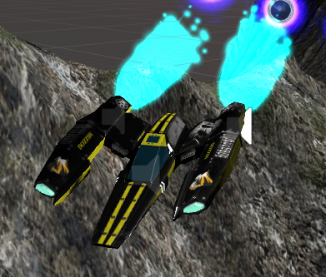
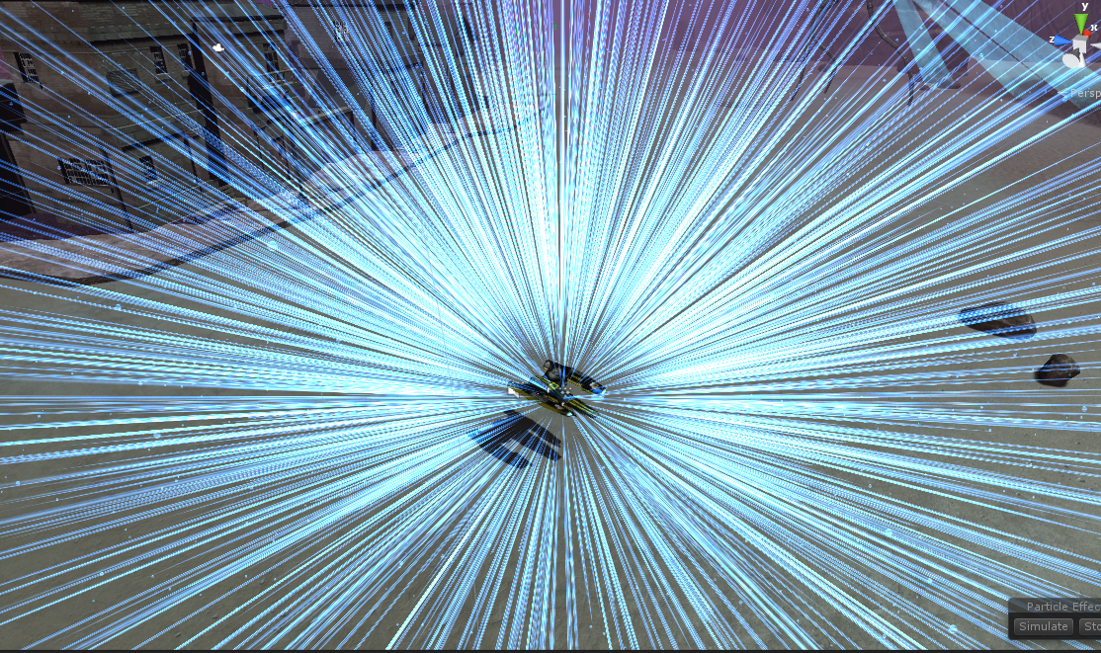
Particle Effects
Unity particle system used for portal effect, vehicle thrusters, and energy pulse, etc
Manipulate particle systems in realtime via C# scripts to change color, speed of particles, angle of discharge, lighting effects, etc.

Slide 11
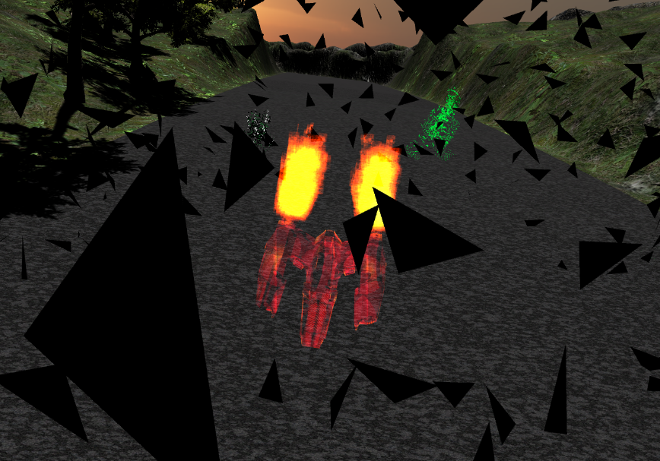
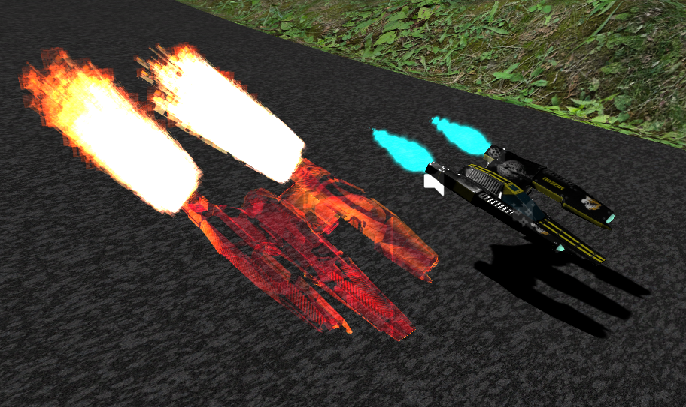
Ghost Racer
Wanted some kind of competition for the player
Effect achieved by recording positional data of previous attempt and ‘playing it back’ by updating ghost position 100 times per second
Automatically race against yourself by replaying the level or race against a difficult opponent from serialized data

Slide 12
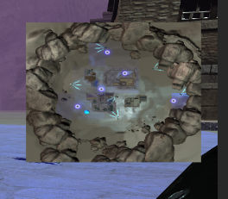
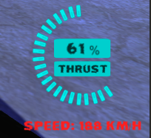
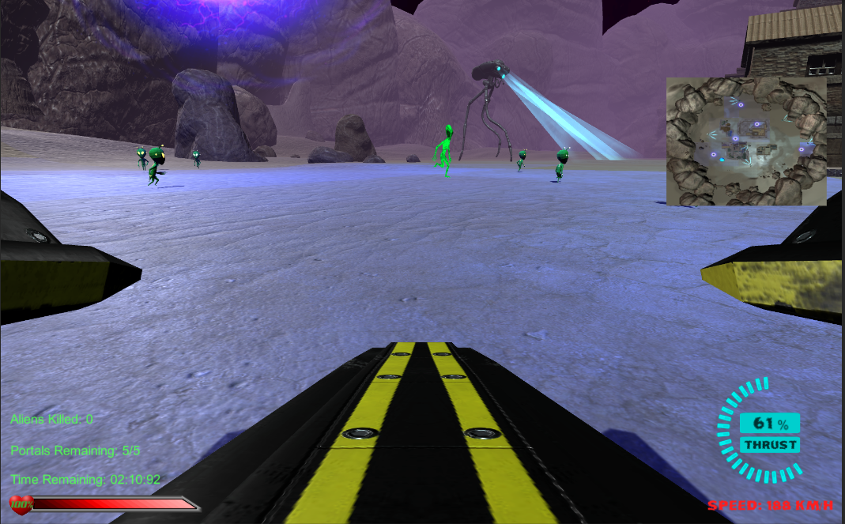
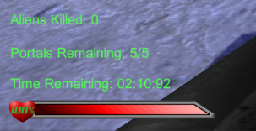
User Interface
Minimap uses second, overhead camera which outputs an orthographic view to a texture that can be rendered in UI layer
Healthbar created using 3 layers of sprites and masking
Thrust meter updated 100 times per second in code

Slide 13
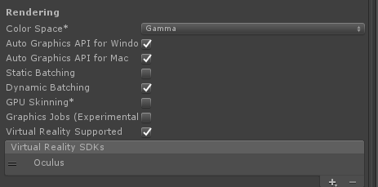
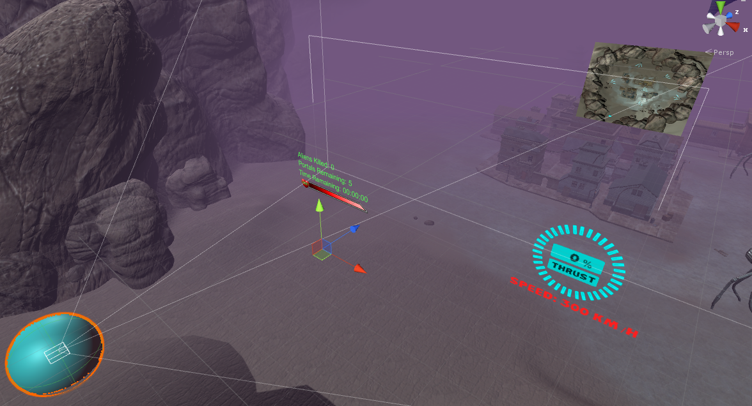
Conversion to VR
Unity handles most of it
Check a box to enable VR support
User interface was a big problem
Traditional UI is too close to the eye to be able to see it
Had to move from Screen Space UI to World Space UI
Time consuming to get just right when trying to support traditional UI and VR UI

Slide 14
Demo

Slide 15
Questions?
Mizzou Box: http://bit.ly/2qlT7i0
Google Drive:
http://bit.ly/2qlVzVQ

